Slide 1
Linear and Logistic Regression
(the SQL way)

Slide 2
What is the purpose of this presentation?
To show if linear or logistic regression is possible with SQL and to provide their implementation
To provide enough arguments whether an SQL implementation of these regressions is worth or not
When is it worth to perform any numerical calculations on the database side.

Slide 3
Presentation Structure
Linear Regression
What is linear regression ?
Use cases
Solving for coefficients in SQL (with demo)
Logistic Regression
What is logistic regression ?
Use cases
Logistic Regression vs Linear Regression comparison
Gradient Descent
Solving for coefficients in C++ demo
Discussion whether SQL implementation of the above is worth it or not?

Slide 4
What is Simple Linear Regression ?
Simple linear regression is a statistical method that allows us to summarize and study relationships between two continuous (quantitative) variables:
One variable, denoted x, is regarded as the predictor, explanatory, or independent variable.
The other variable, denoted y, is regarded as the response, outcome, or dependent variable.

Slide 5
Scatter Plots of Data with Various Correlation Coefficients
Y
Y
Y
X
X
X
Y
Y
Y
X
X
X

Slide 6
Why do we need Linear Regression ?
What dose is required for a particular treatment ?
How many days will take for a full recovery ?
How many cars will be parked here tomorrow ?
How many insurances will be sold next month ?

Slide 7
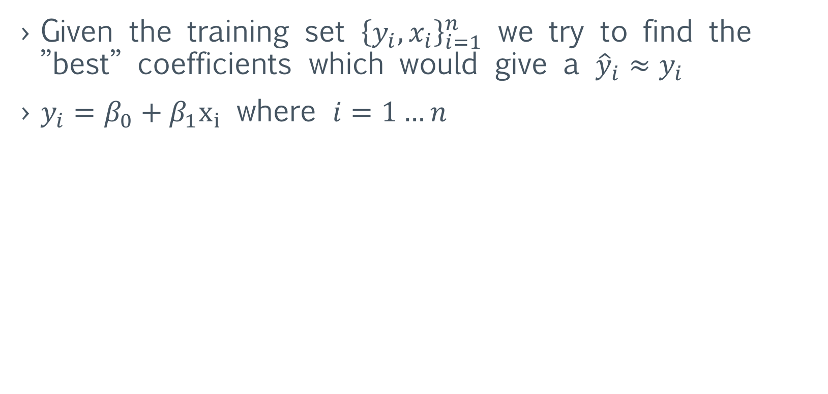
Simple Linear Regression
Given the training set ${\left\{y_{i}, x_{i}\right\}}_{i=1}^{n}$ we try to find the ”best” coefficients which would give a ${\hat{y}}_{i}≈y_{i}$
$y_{i}=β_{0}+β_{1}x_{i}$ where $i=1…n$

Slide 8
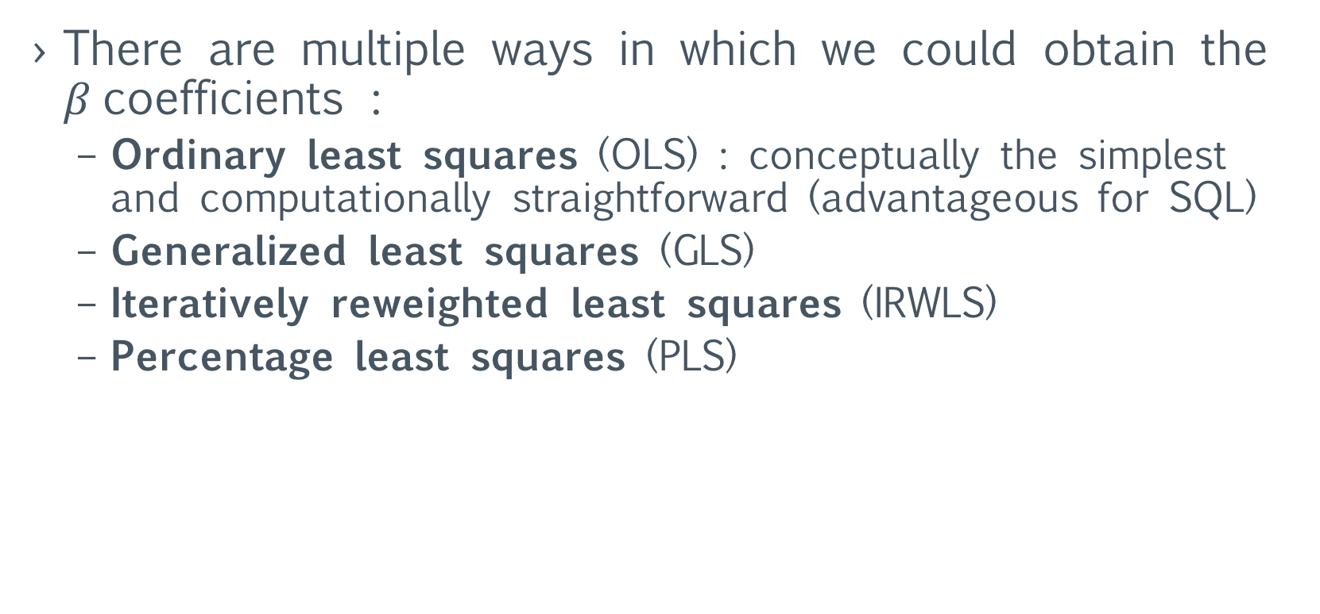
Simple linear regression (SLR)
There are multiple ways in which we could obtain the $β$coefficients :
Ordinary least squares (OLS) : conceptually the simplest and computationally straightforward (advantageous for SQL)
Generalized least squares (GLS)
Iteratively reweighted least squares (IRWLS)
Percentage least squares (PLS)

Slide 9

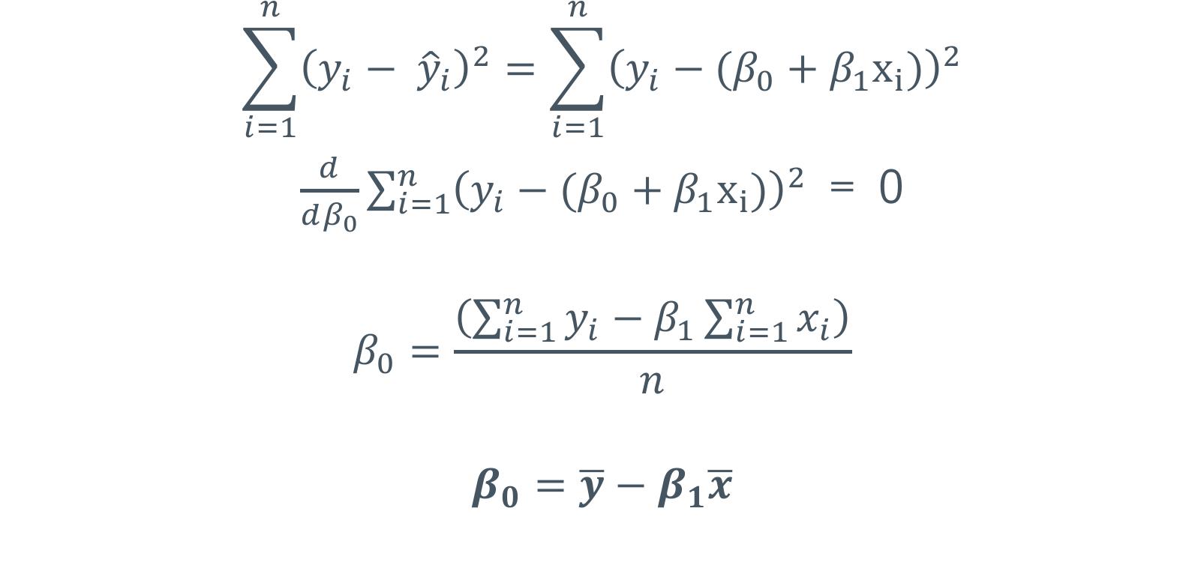
SLR - OLS Minimize $\sum_{i=1}^{n}{{\left({y_{i}− \hat{y}}_{i}\right)}^{2}}$
$$\sum_{i=1}^{n}{{\left({y_{i}− \hat{y}}_{i}\right)}^{2}}=\sum_{i=1}^{n}{{\left(y_{i}−(β_{0}+β_{1}x_{i})\right)}^{2}}$$
$\frac{d}{dβ_{0}}\sum_{i=1}^{n}{{\left(y_{i}−(β_{0}+β_{1}x_{i})\right)}^{2}}$ = 0
$$β_{0}=\frac{\left(\sum_{i=1}^{n}{y_{i}−β_{1}\sum_{i=1}^{n}{x_{i}}}\right)}{n}$$
$$β_{0}=\overline{y}−β_{1}\overline{x}$$

Slide 10
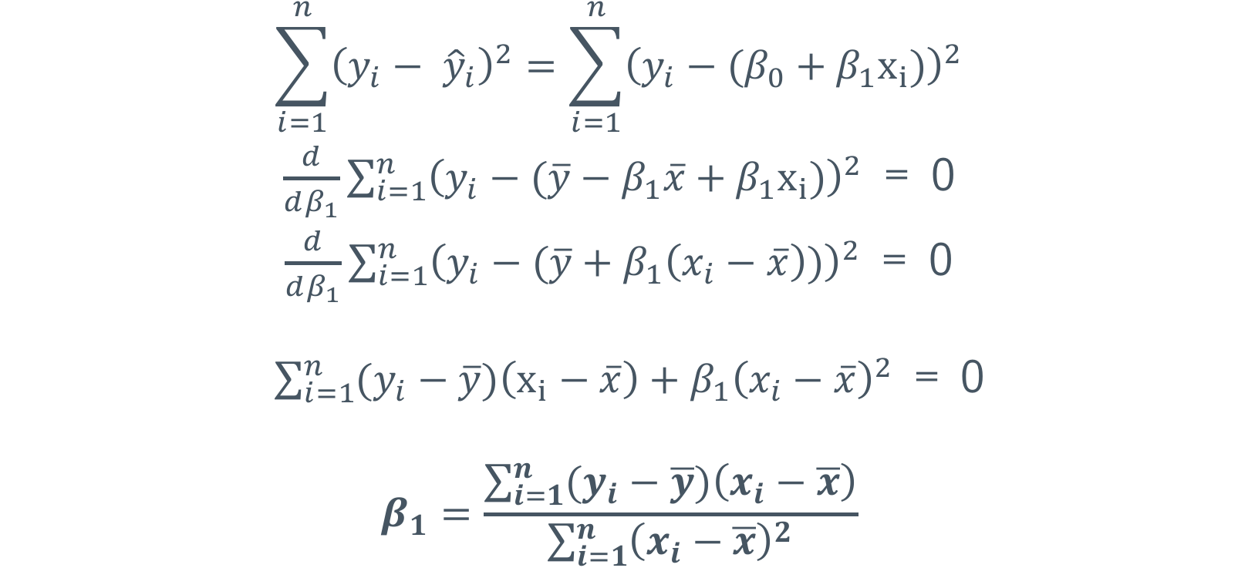
SLR - OLS Minimize $\sum_{i=1}^{n}{{\left({y_{i}− \hat{y}}_{i}\right)}^{2}}$
$$\sum_{i=1}^{n}{{\left({y_{i}− \hat{y}}_{i}\right)}^{2}}=\sum_{i=1}^{n}{{\left(y_{i}−(β_{0}+β_{1}x_{i})\right)}^{2}}$$
$\frac{d}{dβ_{1}}\sum_{i=1}^{n}{{\left(y_{i}−(\overline{y}−β_{1}\overline{x}+β_{1}x_{i})\right)}^{2}}$ = 0
$\frac{d}{dβ_{1}}\sum_{i=1}^{n}{{\left(y_{i}−(\overline{y}+β_{1}\left(x_{i}−\overline{x}\right))\right)}^{2}}$ = 0
$\sum_{i=1}^{n}{(y_{i}−\overline{y})\left(x_{i}−\overline{x}\right)+β_{1}{\left(x_{i}−\overline{x}\right)}^{2}}$ = 0
$$β_{1}=\frac{\sum_{i=1}^{n}{(y_{i}−\overline{y})\left(x_{i}−\overline{x}\right)}}{\sum_{i=1}^{n}{{\left(x_{i}−\overline{x}\right)}^{2}}}$$

Slide 11
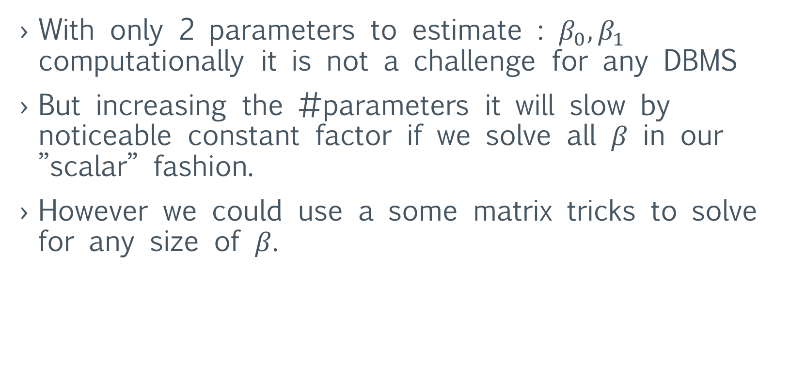
SLR
With only 2 parameters to estimate : $β_{0},β_{1}$ computationally it is not a challenge for any DBMS
But increasing the #parameters it will slow by noticeable constant factor if we solve all $β$ in our ”scalar” fashion.
However we could use a some matrix tricks to solve for any size of $β$.

Slide 12
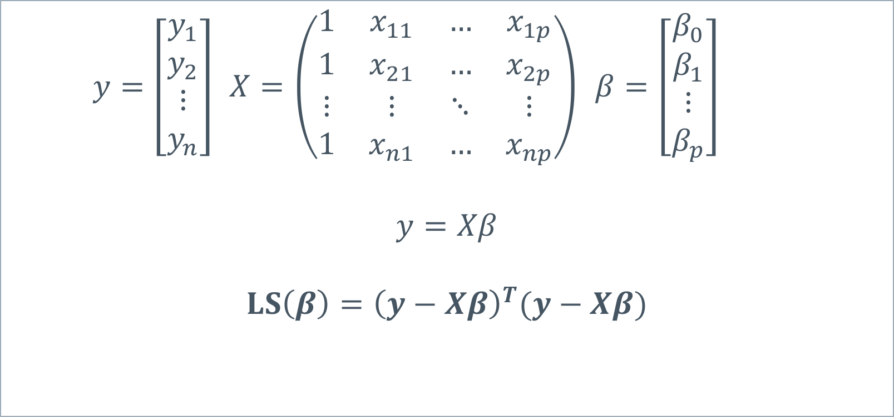
Multilinear Linear Regression with LS
$y=\left[\begin{aligned}y_{1} \\ y_{2} \\ ⋮ \\ y_{n}\end{aligned}\right]$ $X=\left(\begin{matrix}1 & x_{11} & … & x_{1p} \\ 1 & x_{21} & … & x_{2p} \\ ⋮ & ⋮ & ⋱ & ⋮ \\ 1 & x_{n1} & … & x_{np}\end{matrix}\right)$ $β=\left[\begin{matrix}\begin{aligned}β_{0} \\ β_{1}\end{aligned} \\ ⋮ \\ β_{p}\end{matrix}\right]$
$$y=Xβ$$
$$LS\left(β\right)={\left(y−Xβ\right)}^{T}(y−Xβ)$$

Slide 13
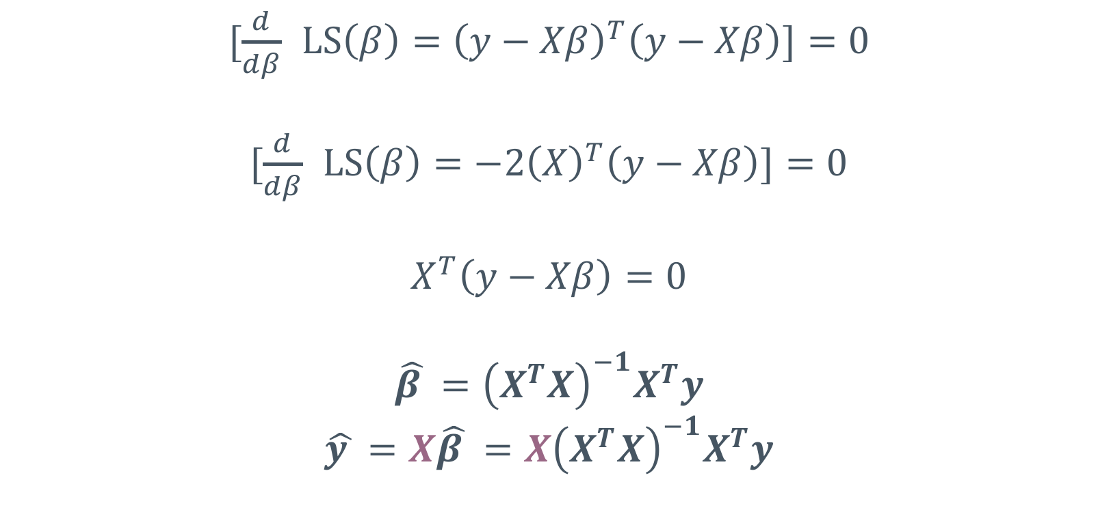

Minimize $LS\left(β\right)={\left(y−Xβ\right)}^{T}(y−Xβ)$
$[\frac{d}{dβ}$ $LS\left(β\right)={\left(y−Xβ\right)}^{T}\left(y−Xβ\right)]=0$
$[\frac{d}{dβ}$ $LS\left(β\right)={−2\left(X\right)}^{T}\left(y−Xβ\right)]=0$
$$X^{T}\left(y−Xβ\right)=0$$
$$\hat{β }={\left(X^{T}X\right)}^{−1}X^{T}y$$
$$\hat{y }=X\hat{β }=X{\left(X^{T}X\right)}^{−1}X^{T}y$$
Notes:
Imagine implementing this in SQL ?

Slide 14

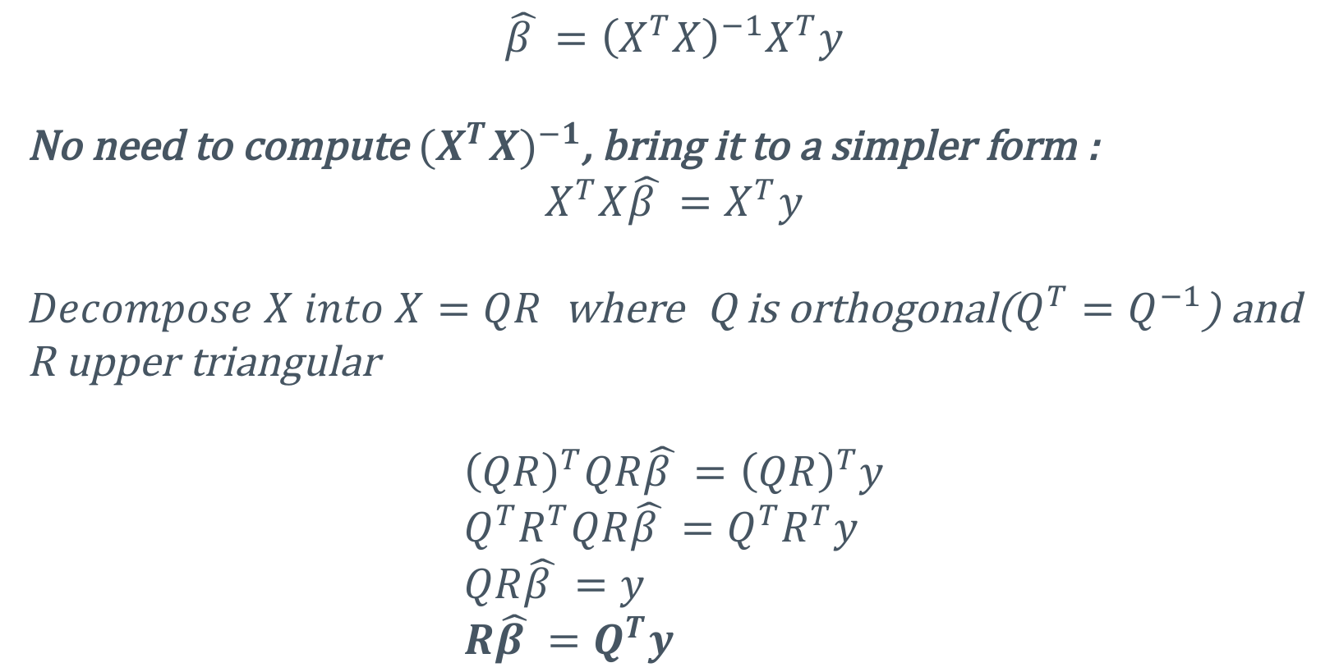
Solving $\hat{y }=X\hat{β }=X{\left(X^{T}X\right)}^{−1}X^{T}y$ with QR
$$\hat{β }={\left(X^{T}X\right)}^{−1}X^{T}y$$
No need to compute ${(X}^{T}{X)}^{−1}$, bring it to a simpler form :
$$X^{T}X\hat{β }=X^{T}y$$
$Decompose X into X=QR$ where Q is orthogonal($Q^{T}=Q^{−1}$) and R upper triangular
$${\left(QR\right)}^{T}QR\hat{β }={\left(QR\right)}^{T}y \\ Q^{T}R^{T}QR\hat{β }=Q^{T}R^{T}y \\ QR\hat{β }=y \\ R\hat{β }=Q^{T}y$$
Notes:
We need to decompose the X matrix into more convenient matrices, into matrices with special properties

Slide 15

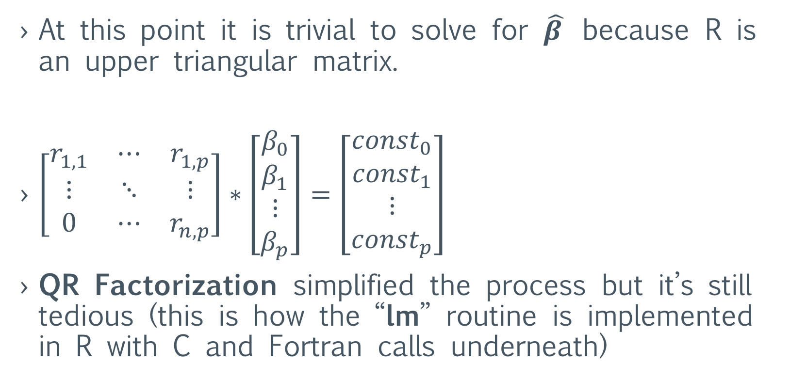
$$R\hat{β }=Q^{T}y$$
At this point it is trivial to solve for $\hat{β }$ because R is an upper triangular matrix.
$\left[\begin{matrix}r_{1,1} & ⋯ & r_{1,p} \\ ⋮ & ⋱ & ⋮ \\ 0 & ⋯ & r_{n,p}\end{matrix}\right]∗\left[\begin{matrix}\begin{aligned}β_{0} \\ β_{1}\end{aligned} \\ ⋮ \\ β_{p}\end{matrix}\right]=\left[\begin{matrix}\begin{aligned}{const}_{0} \\ {const}_{1}\end{aligned} \\ ⋮ \\ {const}_{p}\end{matrix}\right]$
QR Factorization simplified the process but it’s still tedious (this is how the “lm” routine is implemented in R with C and Fortran calls underneath)

Slide 16
Problems with Multiple linear regression ?
Operations for linear algebra must be implemented :
Matrix/vector multiplication
Matrix inverse/pseudo-inverse
Matrix factorization like SVD, QR, Cholesky, Gauss-Jordan
Too much number crunching for an engine which has different purpose, it’s far away from FORTRAN!
Even C++ Boost’s library for basic linear algebra (BLAS) does a poor job in comparison to MATLAB.
Notes:
There are four ways how Matlab code gets sped up:
JIT: compiling at runtime helps with loops but seems to speed up (or at least interact with) other parts of the code as well, according to my anecdotal observations.
Implementing functions in C/C++: There's a bunch of Matlab/Octave functions that are implemented in Matlab/Octave. At every release, there's a bunch more of them that get made into built-ins.
Multithreading: There's a list of functions that have multithreaded implementations, which will speed up function calls.
Generally more efficient implementations. For example the median filter got a massive speed boost for integer inputs a few releases ago.
All of these approaches need developers dedicated to make code faster. As far as I know, a major concern of Octave developers is to make sure (Matlab) functionality is there at all, whereas performance increase seems to have been a focus of Matlab development in the last few years.

Slide 17
What is Logistic Regression ?
To predict an outcome variable that is categorical from predictor variables that are continuous and/or categorical
Used because having a categorical outcome variable violates the assumption of linearity in normal regression
The only “real” limitation for logistic regression is that the outcome variable must be discrete
Logistic regression deals with this problem by using a logarithmic transformation on the outcome variable which allow us to model a nonlinear association in a linear way
It expresses the linear regression equation in logarithmic terms (called the logit)

Slide 18
Logistic Regression Use Cases
Google uses it to classify spam or not spam email
Is a loan good for you or bad?
Will my political candidate win the election?
Will this user buy a monthly Netflix subscription?
Will the prescribed drugs have the desired effect?
Should this bank transaction be classified as a fraud?

Slide 19
Why not Linear Regression instead of Logistic Regression ?
Maybe we could solve the problem mathematically only using Linear Regression for classification ? and that will spare us a lot of complexity.
We would like to classify our input into 2 categories : either a 0 or 1 (ex: 0 → No, 1 → Yes)

Slide 20
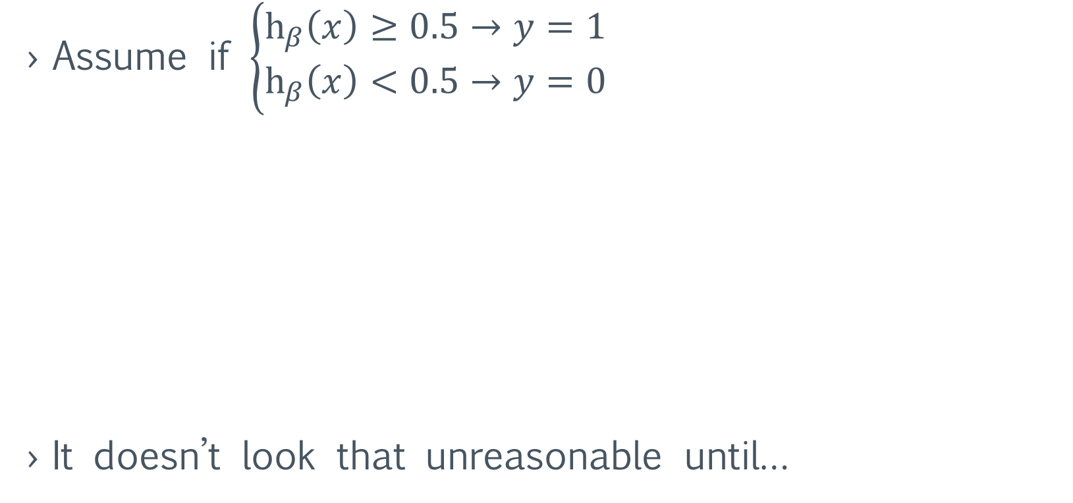
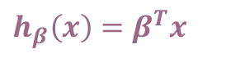
Why not Linear Regression instead of Logistic Regression ?
Assume if $\left\{\begin{aligned}h_{β}\left(x\right)≥0.5→y=1 \\ h_{β}\left(x\right)<0.5→y=0\end{aligned}\right.$
It doesn’t look that unreasonable until…
Real Data, -> Training set
$h_{β}\left(x\right)=β^{T}x$
(1) Yes
(0.5)Malignant?
Tumor Size
(0) No
Notes:
0.5 is called a threshold point

Slide 21
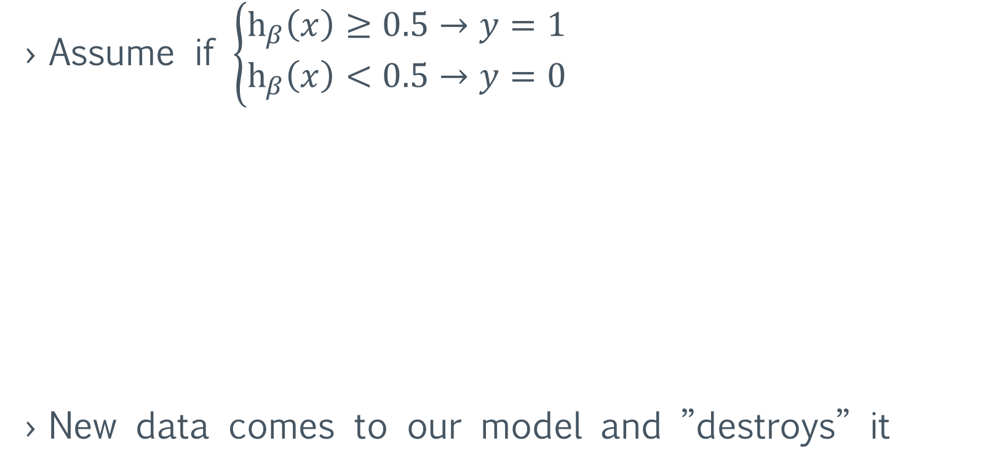
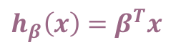

Why not Linear Regression instead of Logistic Regression ?
Assume if $\left\{\begin{aligned}h_{β}\left(x\right)≥0.5→y=1 \\ h_{β}\left(x\right)<0.5→y=0\end{aligned}\right.$
New data comes to our model and ”destroys” it
$h_{β}\left(x\right)=β^{T}x$
${′h}_{β}\left(x\right)={′β}^{T}x$
(1) Yes
(0.5)Malignant?
Tumor Size
(0) No
Notes:
The same function is

Slide 22
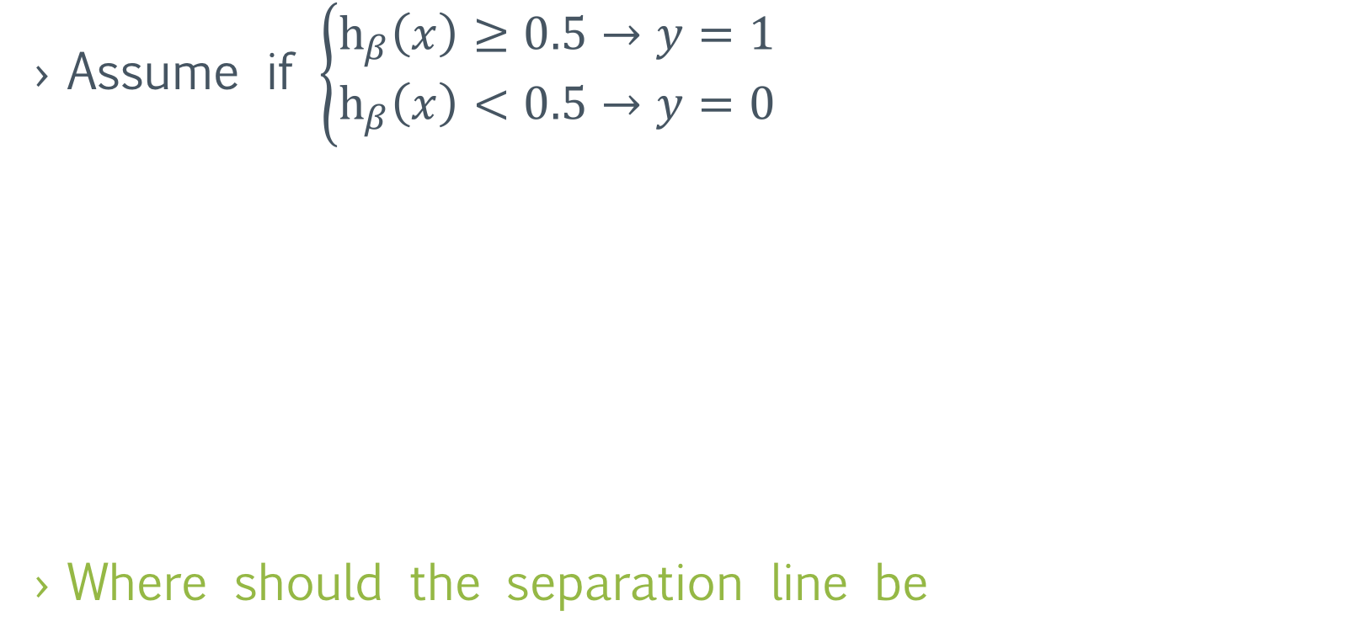
Why not Linear Regression instead of Logistic Regression ?
Assume if $\left\{\begin{aligned}h_{β}\left(x\right)≥0.5→y=1 \\ h_{β}\left(x\right)<0.5→y=0\end{aligned}\right.$
Where should the separation line be
$h_{β}\left(x\right)=β^{T}x$
${′h}_{β}\left(x\right)={′β}^{T}x$
(1) Yes
(0.5)Malignant?
Tumor Size
(0) No

Slide 23
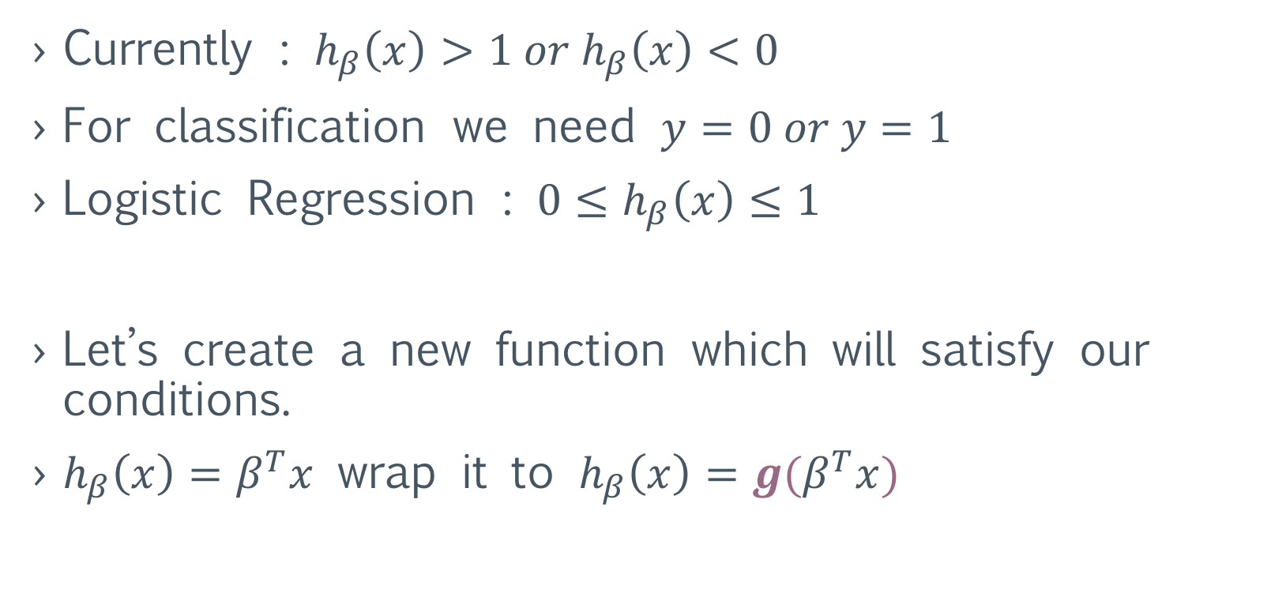
Why not Linear Regression instead of Logistic Regression ?
Currently : $h_{β}\left(x\right)>1 or{ h}_{β}\left(x\right)<0$
For classification we need $y=0 or y=1$
Logistic Regression : $0≤h_{β}\left(x\right)≤1$
Let’s create a new function which will satisfy our conditions.
$h_{β}\left(x\right)=β^{T}x$ wrap it to $h_{β}\left(x\right)=g(β^{T}x)$

Slide 24
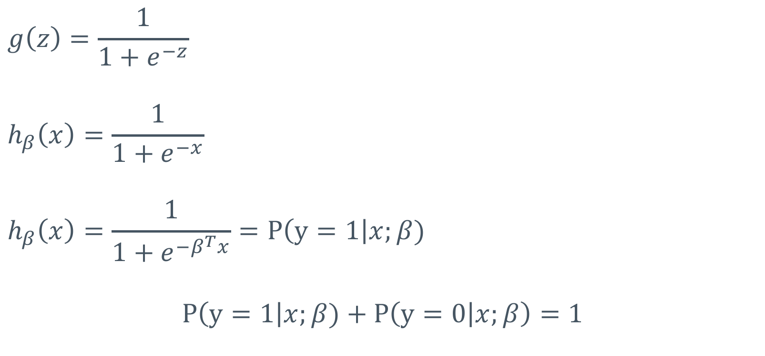
Logistic Regression
$$g\left(z\right)=\frac{1}{1+e^{−z}}$$
$$h_{β}\left(x\right)=\frac{1}{1+e^{−x}}$$
$$h_{β}\left(x\right)=\frac{1}{1+e^{−β^{T}x}}=P\left(y=1\right|x;β)$$
$$P\left(y=1\right|x;β)+P\left(y=0 | x;β\right)=1$$

Slide 25
Gradient Descent
A technique to find minimum of a function
With other words “for which input parameters of the function will I get a minimum output”
Not the best algorithm but computationally and conceptually simple

Slide 26
Gradient Descent Intuition
This technique works well for convex functions.
convex
landing point

Slide 27
Gradient Descent Intuition
This technique is not the best for non-convex functions.
It can potentially find the global min but also local
non-convex
potential landing points

Slide 28
Gradient Descent Intuition

Slide 29
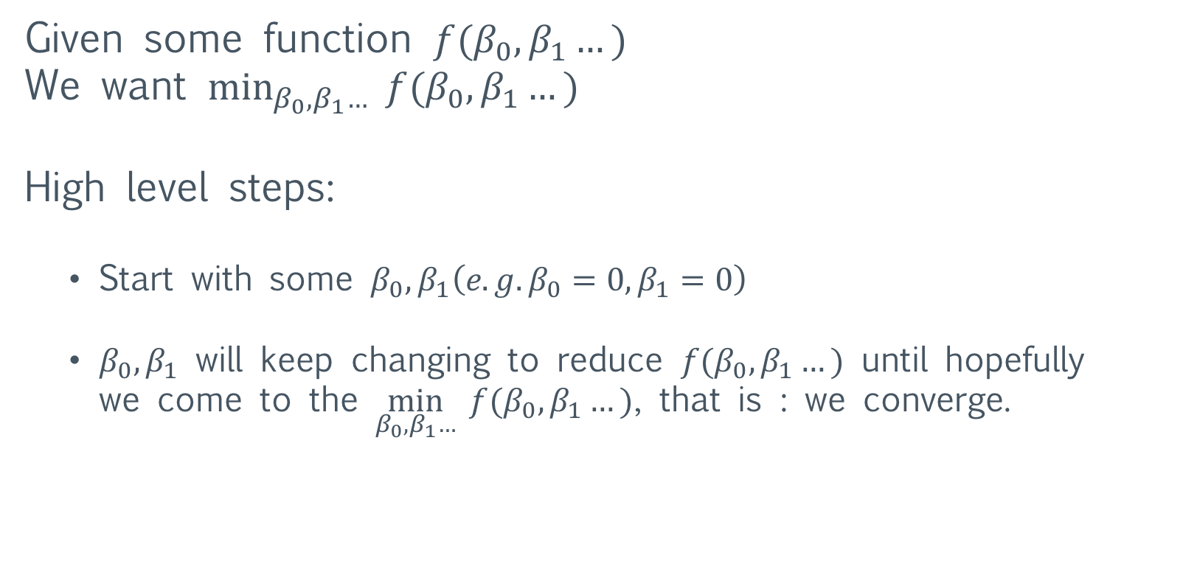
Gradient Descent
Given some function $f(β_{0}, β_{1}…)$
We want $\min_{β_{0},β_{1}…}{ f(β_{0}, β_{1}…)}$
High level steps:
Start with some $β_{0},β_{1}\left(e.g. β_{0}=0, β_{1}=0\right)$
$β_{0},β_{1}$ will keep changing to reduce $f(β_{0}, β_{1}…)$ until hopefully we come to the $\min_{β_{0},β_{1}…}{ f(β_{0}, β_{1}…)}$, that is : we converge.

Slide 30
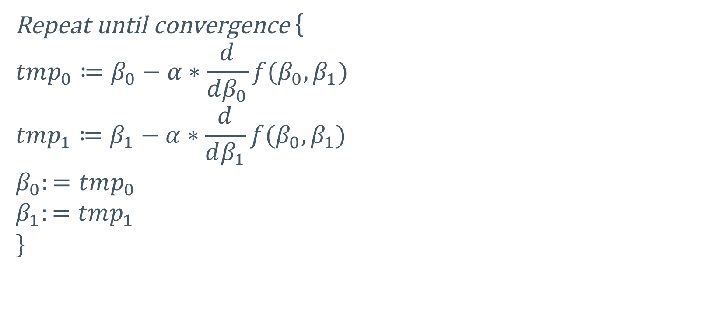
Gradient Descent Algorithm
Repeat until convergence {
$$tmp_{0}≔β_{0}−α∗\frac{d}{dβ_{0}}f(β_{0},β_{1})$$
$${tmp}_{1}≔β_{1}−α∗\frac{d}{dβ_{1}}f(β_{0},β_{1})$$
$$β_{0}:=tmp_{0}$$
$$β_{1}:=tmp_{1}$$
$$\}$$

Slide 31
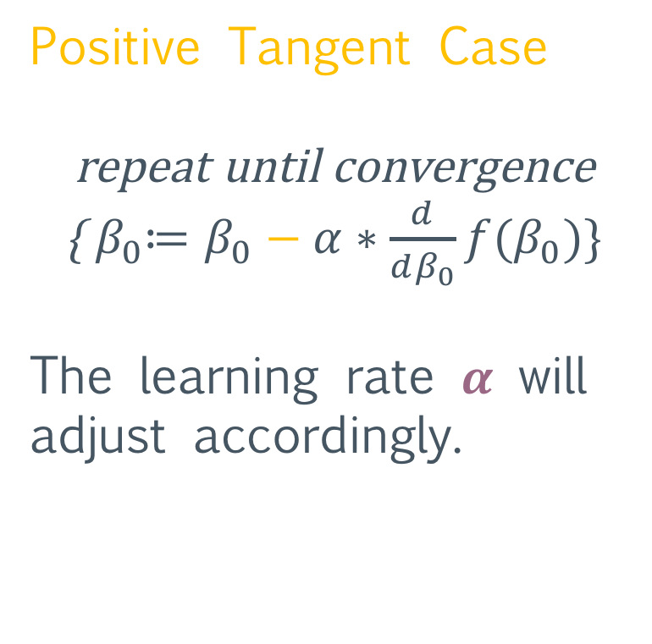

Gradient Descent Intuition
Positive Tangent Case
repeat until convergence {${ β}_{0}≔β_{0}−α∗\frac{d}{dβ_{0}}f(β_{0})\}$
The learning rate $α$ will adjust accordingly.
$$β_{0}$$

Slide 32
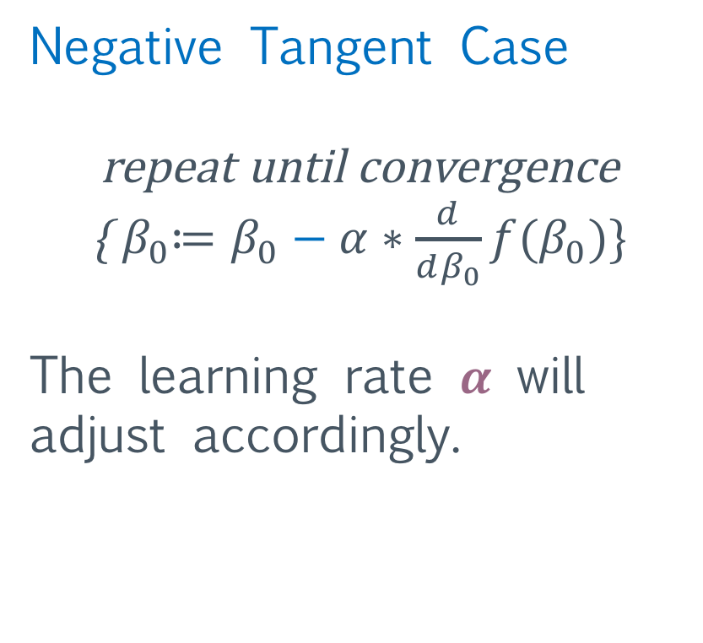
Gradient Descent Intuition
Negative Tangent Case
repeat until convergence
{${ β}_{0}≔β_{0}−α∗\frac{d}{dβ_{0}}f(β_{0})\}$
The learning rate $α$ will adjust accordingly.
$$β_{0}$$

Slide 33
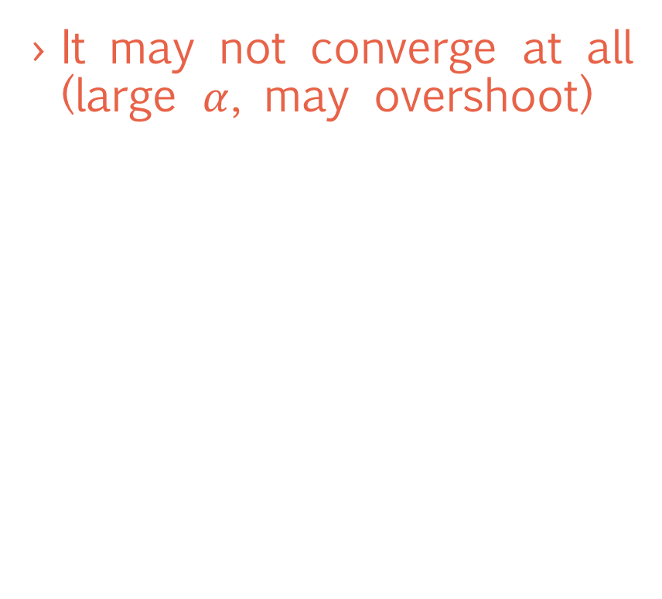
Some Ugly Cases for Gradient Descent
It could converge slow, taking micro steps (almost flat surfaces)
It may not converge at all (large $α$, may overshoot)
Starting point

Slide 34
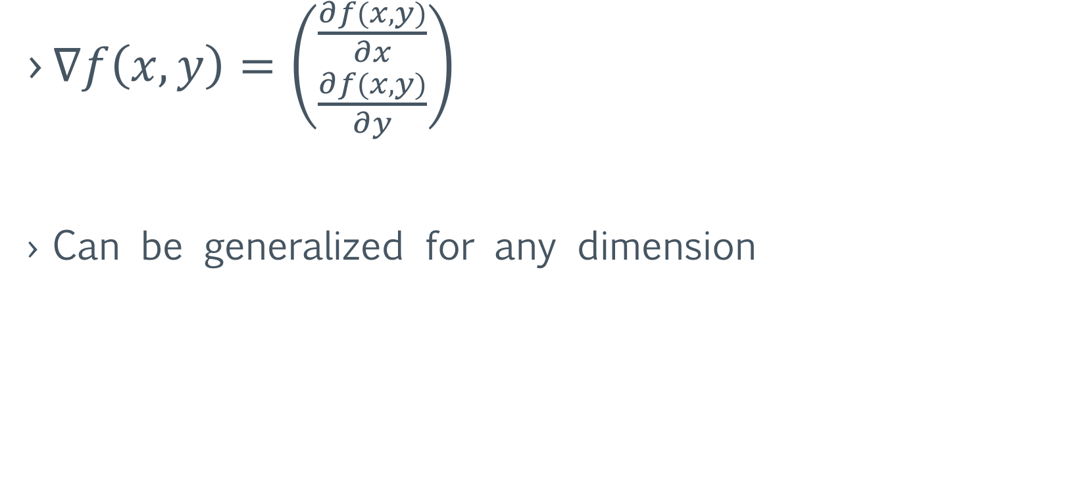
Gradient Descent notation
$∇f\left(x,y\right)=\left({\frac{∂f(x,y)}{∂x} \atop \frac{∂f(x,y)}{∂y}}\right)$
Can be generalized for any dimension

Slide 35
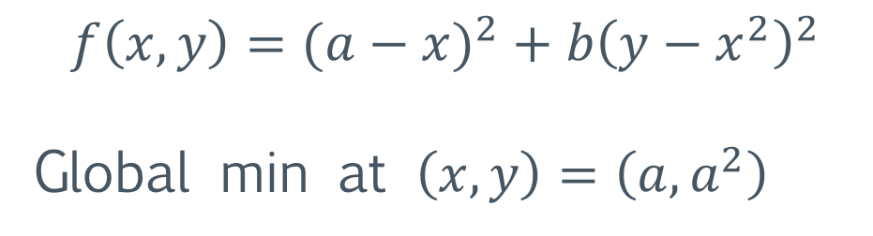
Rosenbrock function
A special non-convex function used as a performance test problem for optimization algorithms.
Also known as Rosenbrock’s valley function or Rosenbrock’s banana function.
$$f\left(x, y\right)=(a−{x)}^{2}+b{\left(y−x^{2}\right)}^{2}$$
Global min at $\left(x,y\right)=\left(a, a^{2}\right)$
Notes:
Usually a=0 and b=100

Slide 37
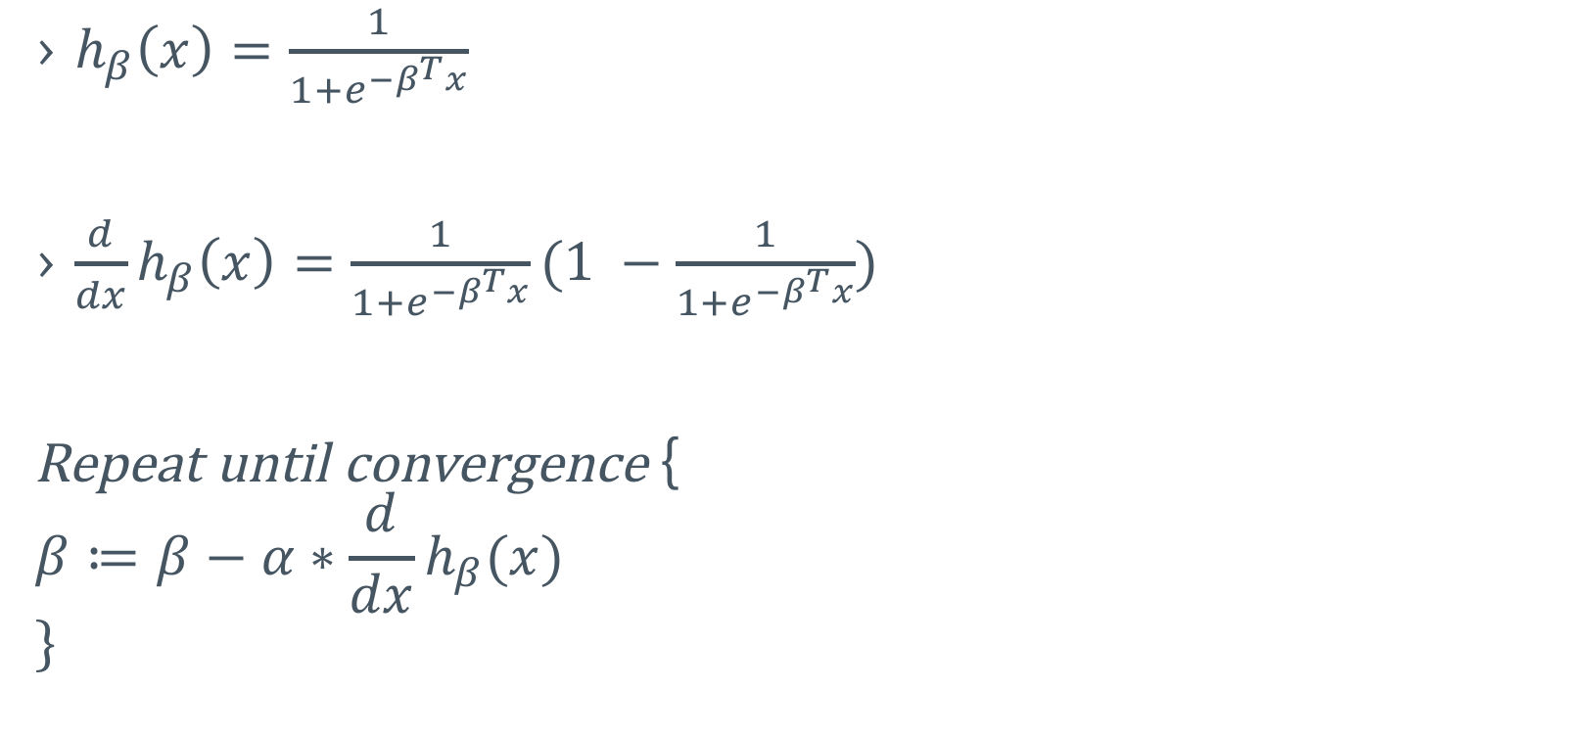
Logistic Regression with Gradient Descent
$h_{β}\left(x\right)=\frac{1}{1+e^{−β^{T}x}}$
$\frac{d}{dx}h_{β}\left(x\right)=\frac{1}{1+e^{−β^{T}x}}(1 −\frac{1}{1+e^{−β^{T}x}})$
Repeat until convergence {
$$β≔β−α∗\frac{d}{dx}h_{β}(x)$$
$$\}$$

Slide 38
Is pure SQL Regression worth it?
Maybe
DEFINETELY NOT
Simple linear regression
Multiple linear regression
Multiple logistic regression
“Numerical” Algorithms
Notes:
Faster depends on the machines involved, if you're talking about faster for one user. If you're talking about faster for a million users hitting a website, then it's more efficient to do these calculations in PHP.
The load of a webserver running PHP is very easily distributed over a large number of machines. These machines can run in parallel, handling requests from visitors and fetching necessary information from the database. The database, however, is not easy to run in parallel. Issues such as replication or sharding are complex and can require specialty software and properly organized data to function well. These are expensive solutions compared to adding another PHP installation to a server array.
Because of this, the value of a CPU cycle on the database machine is far more valuable than one on the webserver. So you should perform these math functions on the webserver where CPU cycles are cheaper and significantly more easy to parallelize.

Slide 39
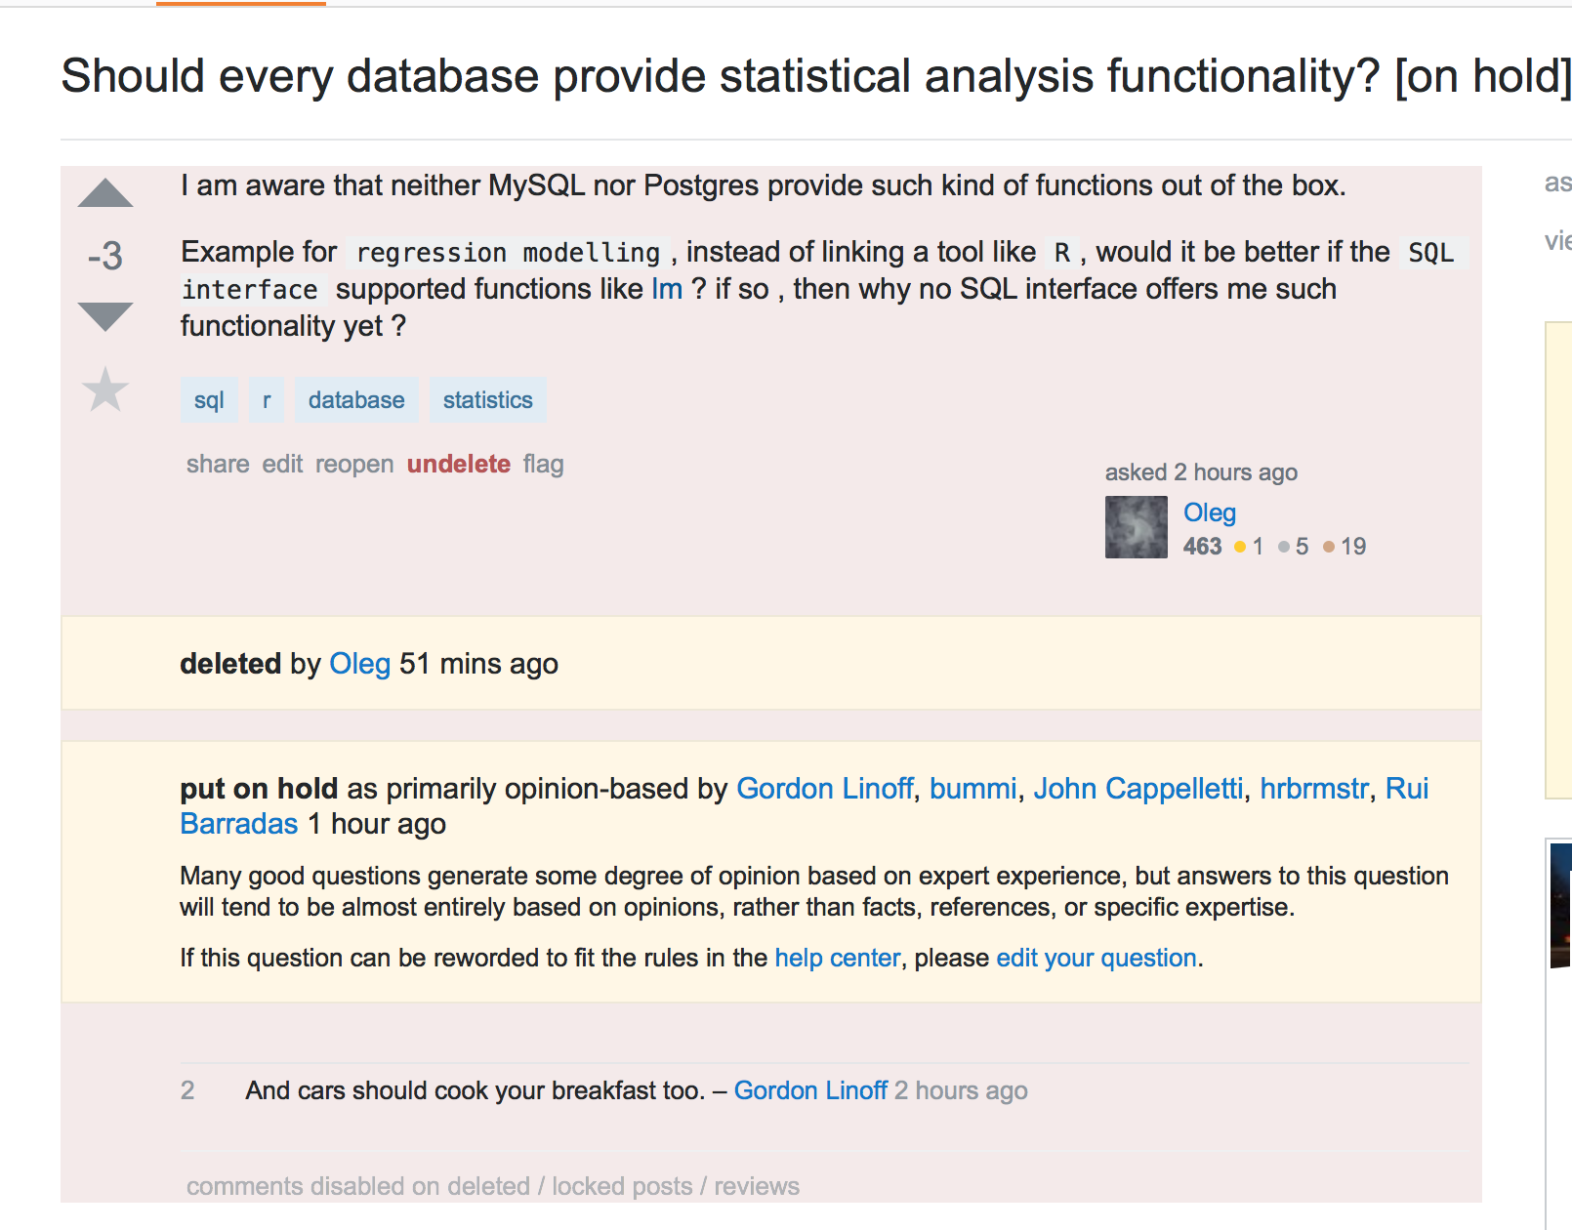
Stackoverflow friendliness

Slide 40
References
https://en.wikipedia.org/wiki/Linear_regression
https://en.wikipedia.org/wiki/Logistic_regression
https://en.wikipedia.org/wiki/Gradient_descent
https://stackoverflow.com/questions/6449072/doing-calculations-in-mysql-vs-php

